Slide 1
The Silver Lining A Deep Dive into the Architecture of Distributed Databases
Michael Meadows
Director: Enterprise Application Integration
Quick Solutions, LLC
@AntiArchitect
Notes:
2:15

Slide 2
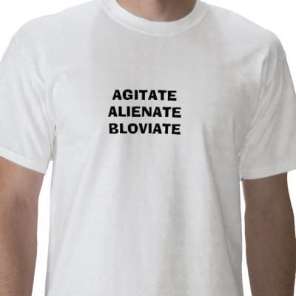
What the Frog am I Going to Say
An Anecdote
An Education
Remedial
100 Level
200 Level
400 Level
Post-Graduate
A Conclusion
http://1.bp.blogspot.com/-2_8oe-lQBAg/TfkRXpdYNxI/AAAAAAAABDo/bh6yKxLBFUg/s1600/bloviate.jpg
Notes:
4:00

Slide 3

An Anecdote
http://mikelfrench.org/blog/P75/P75
Notes:
9:00
Talk about:
EDI system
DANG
1,000,000 transactions per minute
Oracle RAC

Slide 4
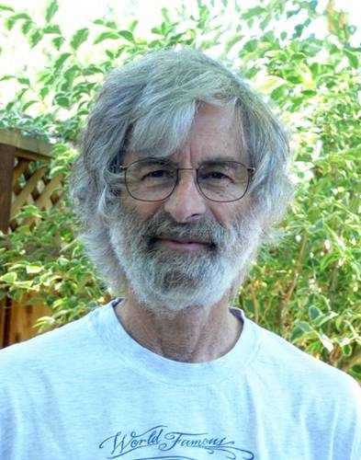
Leslie Lamport
Importance of Clocks In Distributed Systems
Sequential Consistency
Global State in Distributed Systems
Tons of Algorithms:
Praxos Algorithm for Consensus
Bakery Algorithm for Mutual Exclusion
Snapshot Algorithm for Consistent Global State
Byzantine Generals
Part-Time Parliment
Notes:
12:30
Leslie Lamport and 7 seconds
max_commit_propagation_delay and propagate on commit

Slide 5
Oracle 9i Was Distributed
RAC used Replication to Distribute
Lamport’s 7 Second SCN Delay = Eventual Consistency
System Change Number
Enforces sequential ordering of transactions
Promise of Distribution
Notes:
15:00

Slide 6
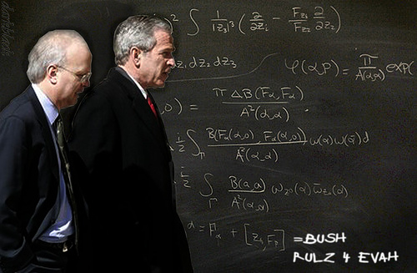
A Remedial Education
What is Database Distribution
Servers versus Nodes
Replication versus Duplication
Notes:
17:00
A database is distributed whenever more than one node act as a logical database
A node is different than a server
Replication is a way to distribute, but duplication is another way.
Replication ensures fast writes, but requires serializable locking to ensure consistency
Duplication is complex in large scale distributed systems, and can generate a lot of network traffic

Slide 7
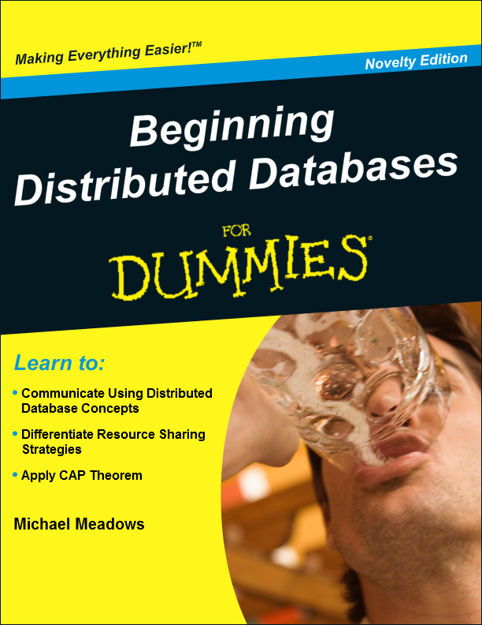
DDDD 101
Concepts
Why Distribute
Distribution Approaches
Problems and Solutions
Distribution Strategies
Shared Nothing vs Shared Disk vs Shared Whatever
CAP vs ACID vs BASE
Notes:
22:00
Web scale
Tell story about experience as SOA architect
Web scale is starting small, and scaling out to any size
Commodity Hardware
Shared Nothing, Disk, Cache

Slide 8
DDDD 101: CAP Theorem
Consistency
Availability
Partition Tolerance
PostgreSQL
SQL Server
MySQL
Oracle
MongoDB
Redis
Cassandra
CouchDB
Notes:
25:00
CAP
Consistency – All nodes see the same data at the same time
Availability – Every request receives a response whether it succeeds or fails
Partition Tolerance – The system continues to operate despite the loss of arbitrary portions of the system
Consistency + Availability = Traditional RDBMS… don’t distribute well
Consistency + Partition Tolerance = Master/slave systems
Partition Tolerance + Availability = Eventually Consistent databases

Slide 9
DDDD 101: ACID vs BASE
ACID
BASE
Atomic
Consistent
Isolated
Durable
Basic Availability
Soft-State
Eventual Consistency
Notes:
27:00
ACID
Atomic – Succeeds or fails and is rolled back
Consistent – The database cannot be in an inconsistent state
Isolated – Transactions cannot interfere with each other
Durable – Data is forevah!
BASE
Basic Availability – The system will always respond, even if the data is not current
Soft-State – Developers will handle data consistency, the database will not enforce it
Eventual Consistency – If given time, data will become consistent

Slide 10
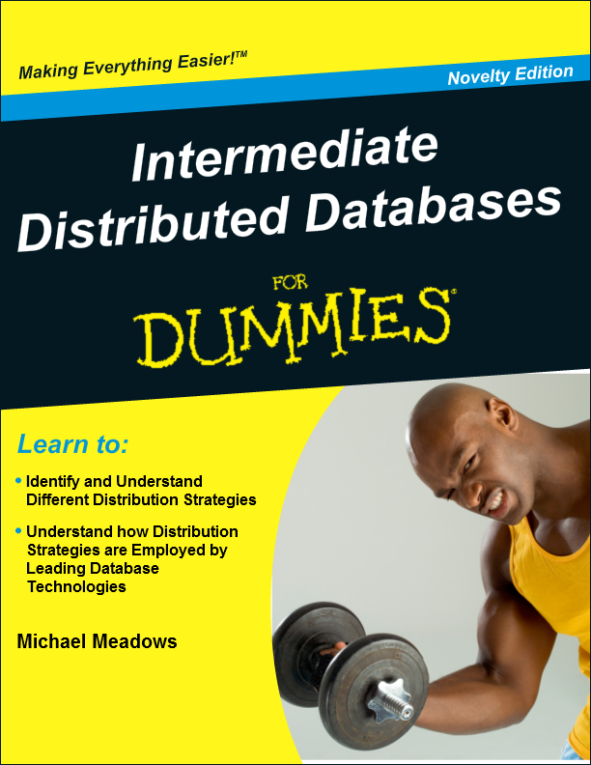
DDDD 200
Teh Mathz
W vs R vs N
Strong vs Weak Consistency Models, Formula Edition
Notes:
29:00
W = Nodes Written
Quorum Versus Distributed Transactions
R = Nodes Read
N = Total Nodes
Strong Consistency Models Require disproportionate amounts of hardware as they scale out

Slide 11

DDDD 200: Strong Consistency
$W+R>N, W>\frac{\left(N+1\right)}{2}$
Notes:
30:00
Vendor technologies mitigate these formulas somewhat
All other vendor provided technologies aside

Slide 12

DDDD 200: Strong Consistency
$N=1$
1 Node
Write to Only Node
Read from Only Node
Guaranteed Consistency
Weak Availability
No Partition Tolerance
Notes:
30:30

Slide 13
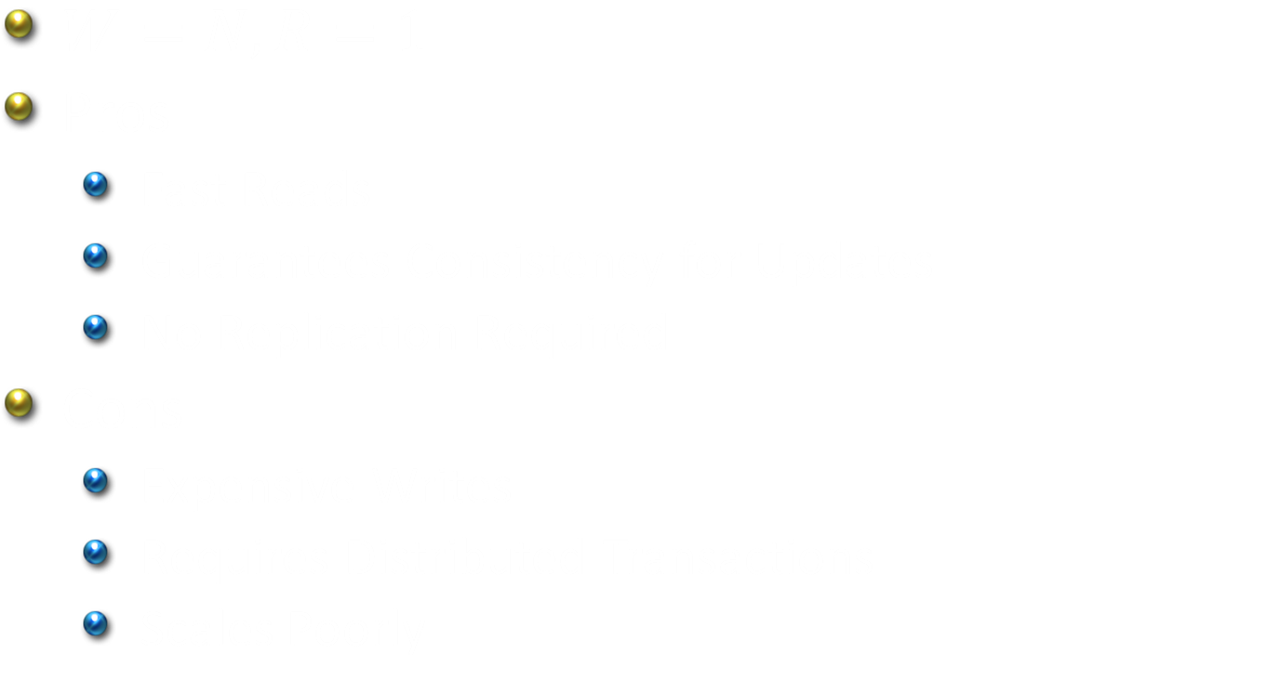
DDDD 200: Strong Consistency
$W=N, R=1$
Pros
Fast Reads
Guarantees Consistency for Updates
No Replication Required
Cons
Expensive Writes
Requires Distributed Transactions
Scales Poorly
Notes:
32:00

Slide 14
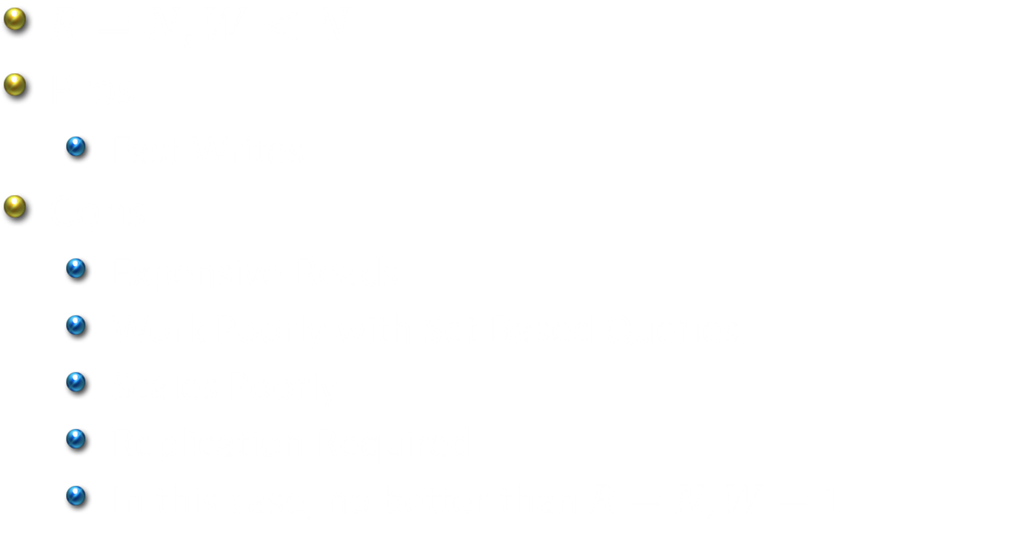
DDDD 200: Strong Consistency
$R=N,W<N$
Pros
Fast Writes
Cons
Expensive Reads
Work Poorly with Set Based Queries
Scales Poorly
Replication Required
In this case, no better than $R=N,W=1$
Notes:
33:00

Slide 15
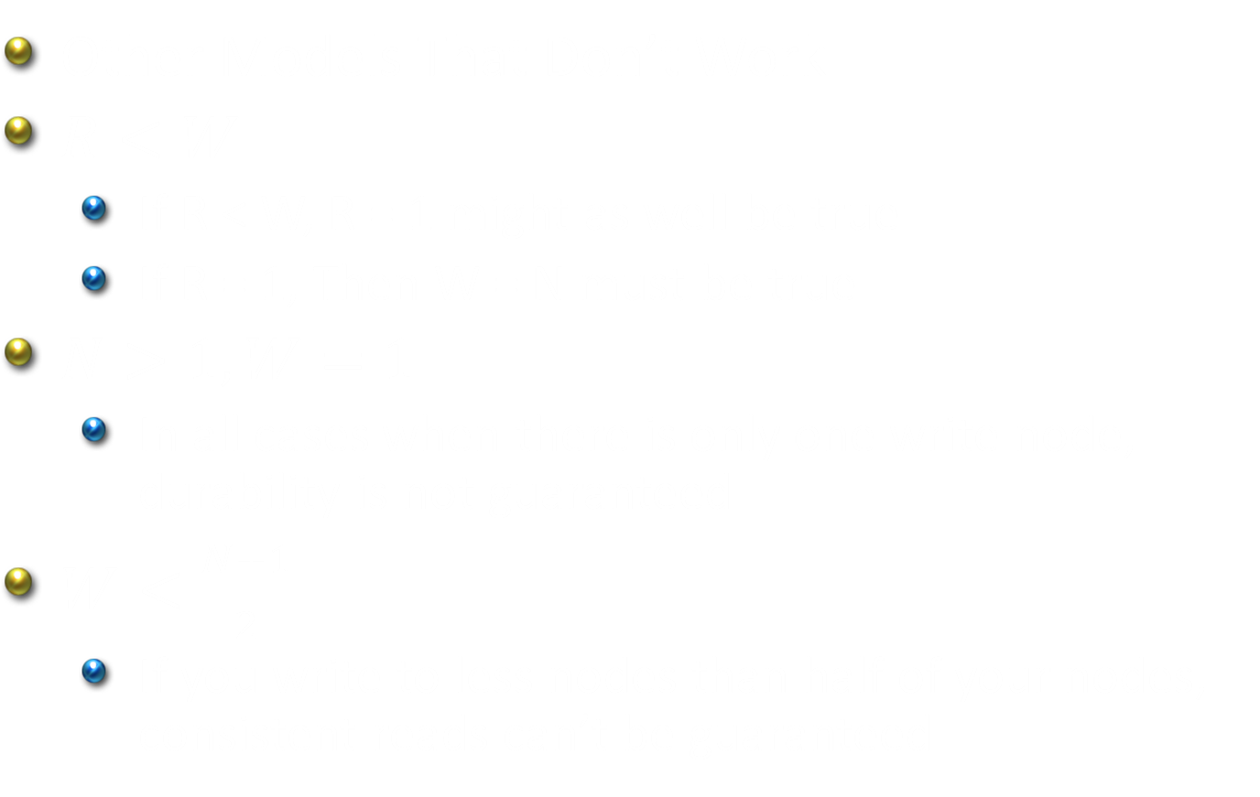
DDDD 200: Strong Consistency
Other Models That Don’t Work
$R<W$
If R < W, R = 1 might as well be true
If R = 1, Then W = N must be true
$N>1,W=1$
In all cases when there is only one write node, durability is not guaranteed
$W<\frac{N+1}{2}$
If you write to less nodes than half of your nodes, consistent reads can’t be guaranteed
Notes:
34:30

Slide 16

DDDD 200: Weak Consistency
$W+R≤N$
$R=1$ makes sense
$W$ is desired nodes for a quorum
Notes:
35:15

Slide 17
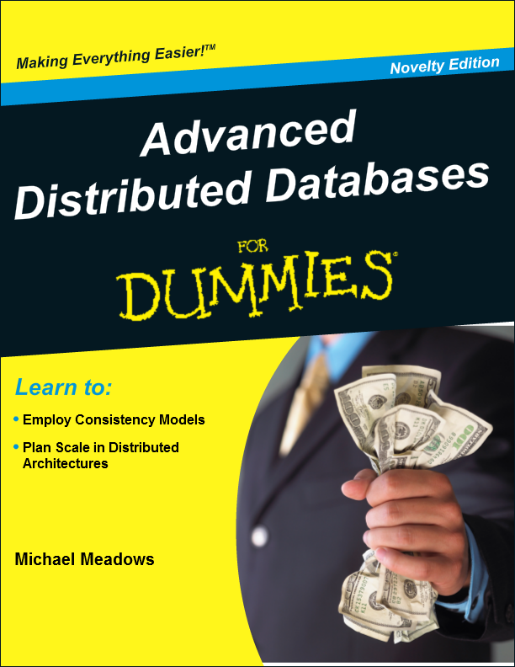
DDDD 435
Strong consistency vs weak consistency vs eventual consistency
Eventual consistency comes in many flavors, most are not mutually exclusive
Databases don’t solve the eventual consistency problem. Applications must deal with read inconsistencies
Notes:
36:30
Strong Consistency: After an update, any subsequent access on any node will return the same value
Weak Consistency: Consistency can only be achieved after certain conditions are met (time or other events)
Eventual Consistency: Guarantees that if nothing else changes except time, consistency will eventually be achieved
Consistency models are not mutually exclusive

Slide 18
DDDD 435: Causal Consistency
Consistency only exists between processes with a formal relationship
Writes are not guaranteed in order
Notes:
37:30

Slide 19
DDDD 435: Sequential Consistency
The result of any execution is the same as if the operations of all the processors were executed in some sequential order, and the operations of each individual processor appear in this sequence in the order specified by its program.
Guarantees all nodes see writes in the same order
Oracle SCN
Notes:
39:00

Slide 20
DDDD 435: Read-Your-Writes
Any process that writes data will never see data older than what it has written
Difficult to enforce in database
Easy to enforce using local cache
Notes:
39:40

Slide 21
DDDD 435: Session Consistency
A special form of read-your-writes that uses session persistence to provide consistent reads
Used in applications where sessions provide simplified caching
Notes:
40:00

Slide 22
DDDD 435: Monotonic Read
Once a process has seen a particular value, it will only see the same or newer value
“Rachets” reads for a process, ensuring that it never sees data older than previous reads
Particularly problematic for systems of weak consistency
Notes:
41:30

Slide 23
DDDD 435: Monotonic Write
Guarantees that writes by the same process will be serialized
Systems that do not provide monotonic writes are extremely difficult to program
Applications should avoid the need for monotonic writes (limit relationships)
Notes:
43:30

Slide 24

DDDD Post-Grad
Isolation
Read Committed
Read Uncommitted
Repeatable Read
Serializable
Distributed Transactions
Requires serializable isolation
Virtually impossible in distributed databases
http://pixabay.com/en/photos/graduates/
Notes:
46:00
Isolation
Read Uncommitted – Allows dirty reads, you can see uncommitted data
Read Committed – Ensures that data is committed before reading, or a select operation is made within the transaction
Repeatable Read – Like read committed, except a select won’t release the lock
Serializable – Does not allow any other reads or writes during a transaction (blocks, or serializes)
Distributed Transactions
Two-Phase Commit are virtually impossible in distributed systems, requiring locks on all nodes (serializable isolation)

Slide 25
DDDD Post-Grad (continued)
Table Design
Avoid relationships
Do not delete or update (add only)
Timestamp all records, merge when necessary
Retrieving Data
Know what you are searching for… use views or views to find data
Use views to retrieve sets, only select single records directly
Use inverted index technologies such as Solr
Notes:
50:00

Slide 26
Conclusions
Why go through all the trouble?
Why should I care?
Why aren’t RDBMS good candidates for distribution?
Isn’t this just for special cases?
What about Hadoop?
What about views and indices?
Notes:
60:00

Slide 27

The Slides
https://github.com/WalkingDisaster/Sessions
goo.gl/V2zdPQ

